Slide 1







Pizza Sales Analytics

Slide 2


Hello everyone!
My name is Gavin Aranha,
In this Pizza Sales Analytics project, I’ve leveraged SQL queries to address questions related to pizza sales.
Through data analysis and insights, we’ll explore key trends and patterns in pizza consumption.
Let’s dive in!

Slide 3
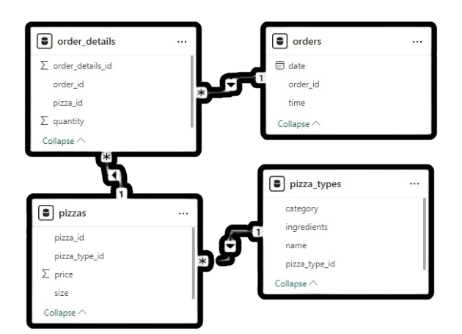
Data MOdel

Slide 4
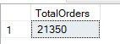
Retrieve the total number
of orders placed.

Slide 5
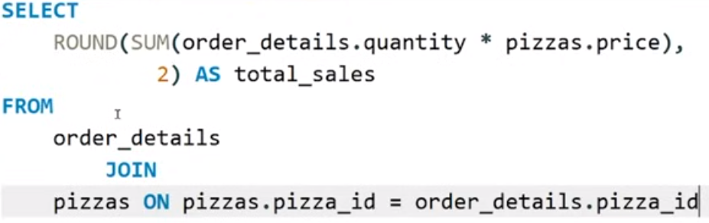
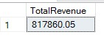
Calculate the total revenue generated from pizza sales.

Slide 6
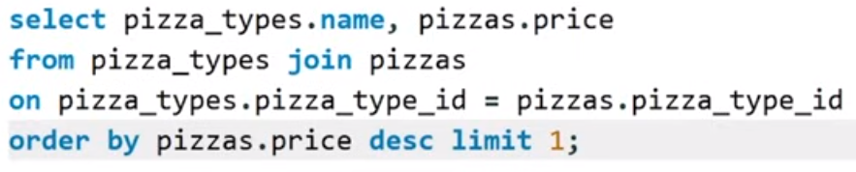
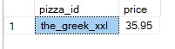
Identify the highest-priced pizza

Slide 7
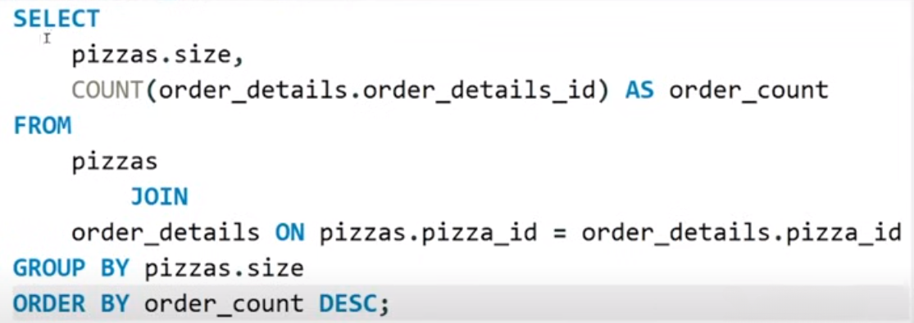
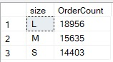
Identify the most common pizza size ordered.

Slide 8
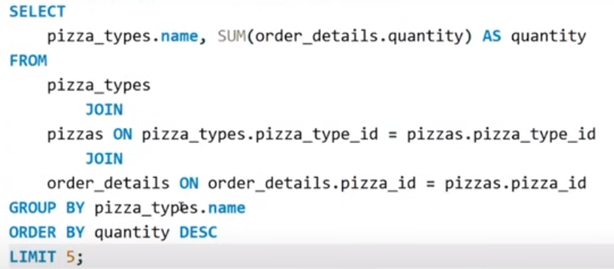
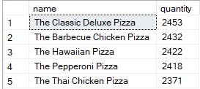
List the top 5 most ordered pizza types along with their quantities

Slide 9
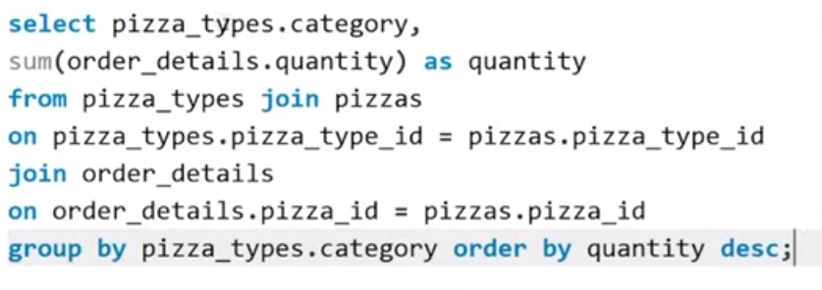
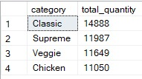
Join the necessary tables to find the total quantity of each pizza category ordered.

Slide 10
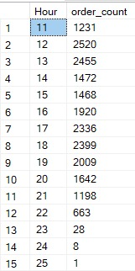
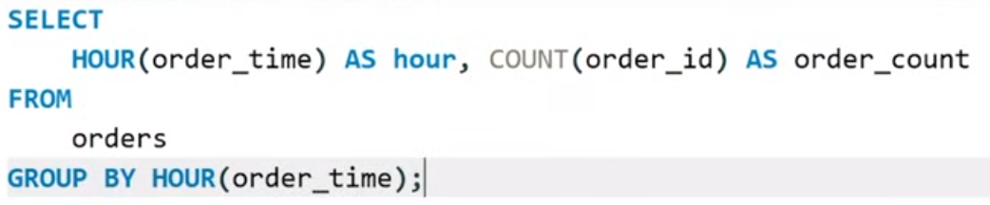
Determine the distribution of orders by hour of the day.

Slide 11
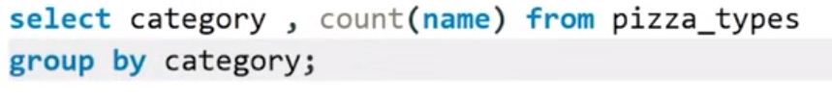
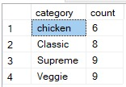
Join relevant tables to find the category-wise distribution of pizzas

Slide 12
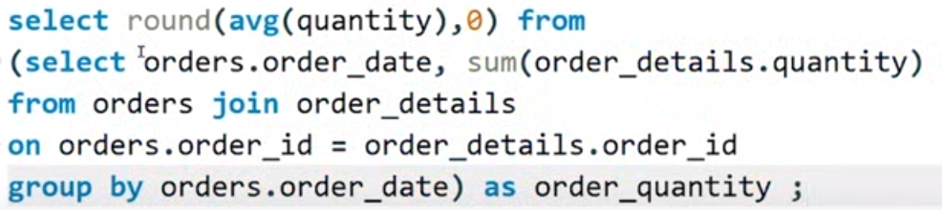
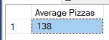
Group the orders by date and calculate the average number of pizzas ordered per day.

Slide 13
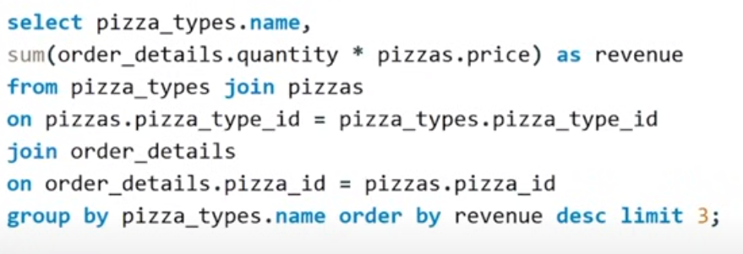
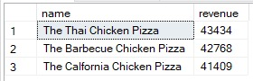
Determine the top 3 most ordered pizza types based on revenue.

Slide 14
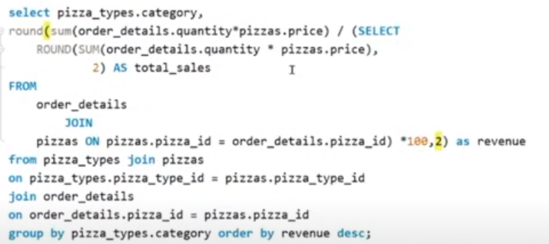
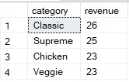
Calculate the percentage contribution of each pizza type to total revenue.

Slide 15
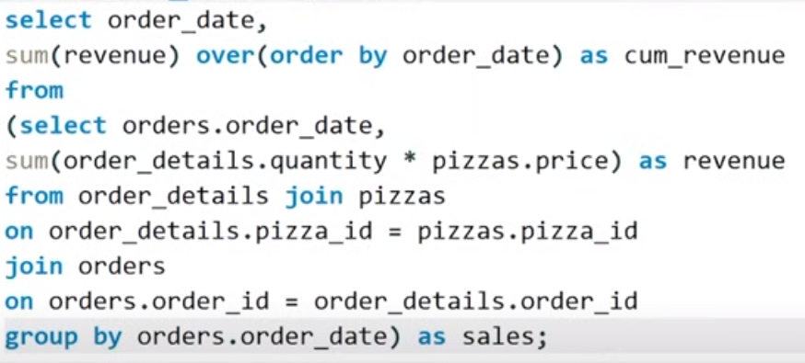
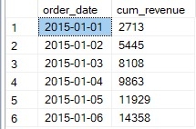
Analyze the cumulative revenue generated over time.

Slide 16
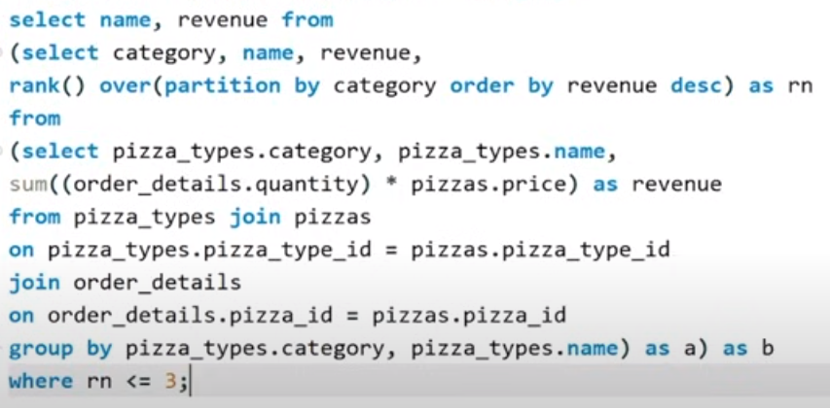
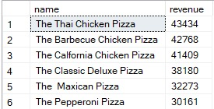
Determine the top 3 most ordered pizza types based on revenue for each pizza category.

Slide 17



THANK YOU

